Slide 1
Big Data

Slide 2
Agenda
Story of Big Data
What is big data?
How big the big data is?
5Vs
Types of Big data
Examples
Problems with big data
Solution

Slide 3
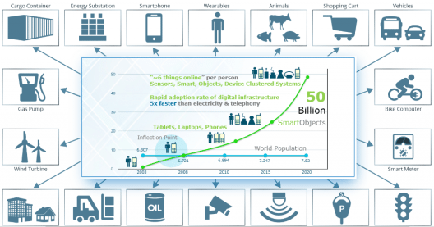
Where it got started?
In 1880, Herman invented tabulating machine, punch cards.
In 1927, Australian- German engineer, developed storing information magnetically on tape

Slide 4
Traditional vs modern db

Slide 5
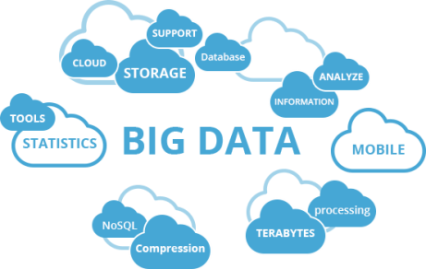
Big Data
Big data is larger, complex data sets.
Traditional data processing software can’t manage them.
Storing, Integration of large data sets for analytics.
Sources of big data:
Web data, e-commerce
Bank/Credit Card transactions
Social Network
Weather, location
Sensor, Machine, IOT

Slide 6
How Big the data is?
Instagram
40 billion pics
4.2B likes
700 million monthly users
95 million photos added everyday
Mail 200,000,000
Youtube
300 hours of video uploaded
Facebook 4,166,667 likes & 200,000 photos
2B monthly users
1.3B daily users
350 million photos added everyday
5,00,000 comments per minute
8B video views everyday
Twitter
1.3B accounts
310 million mothly users
6k tweets per second

Slide 7
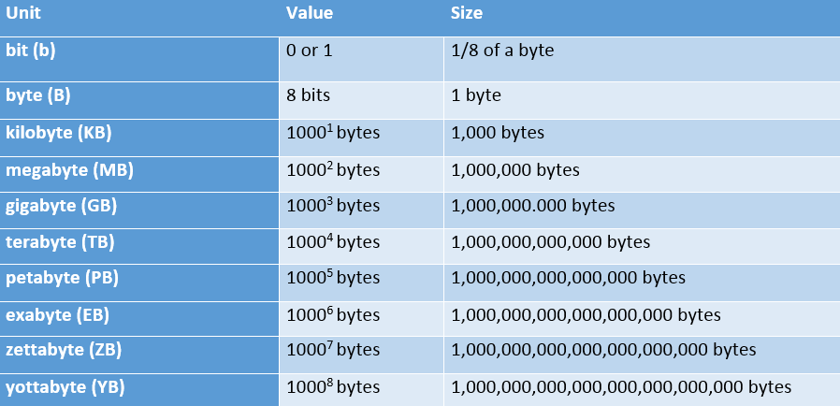
Characteristic of Big Data: Volume

Slide 8













Variety

Slide 9
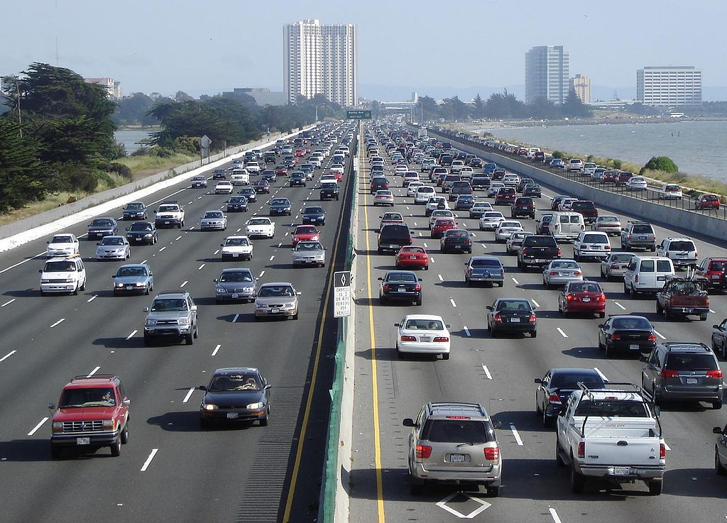
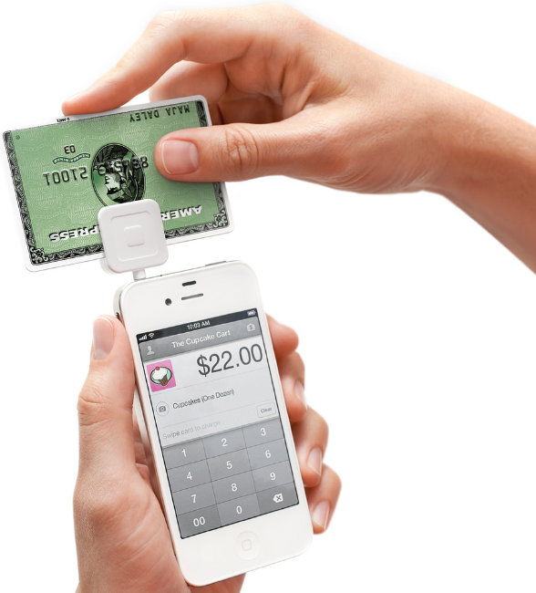
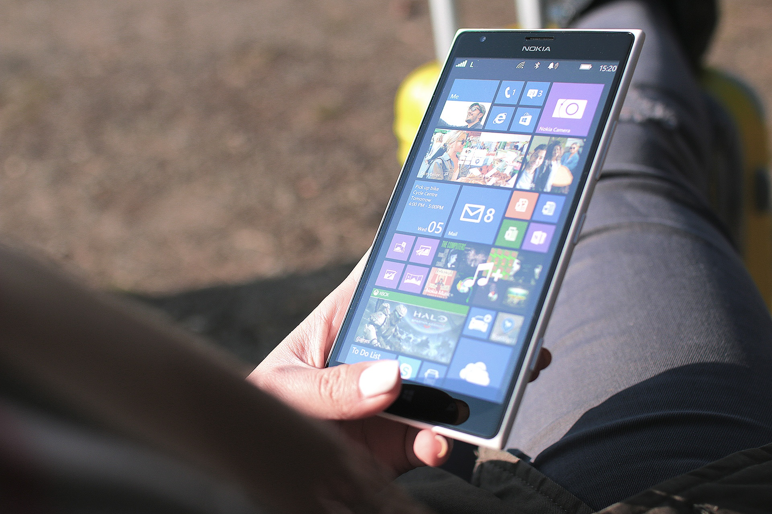



Velocity

Slide 10
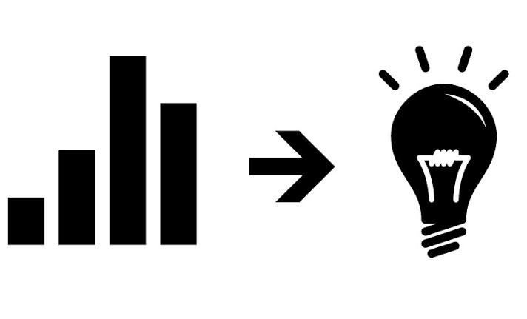

Value
correct meaning out of the data
Veracity
Uncertain and inconsistent in data

Slide 11
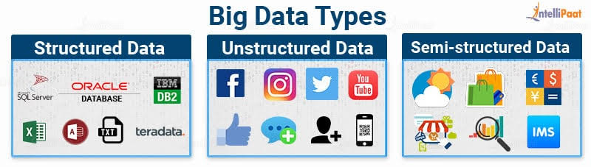
Types of Big data
- Structured
eg: Database
- Unstructured
eg: photos, videos
- Semi-Structured
eg: xml, json

Slide 12
Examples of Big data

Slide 13
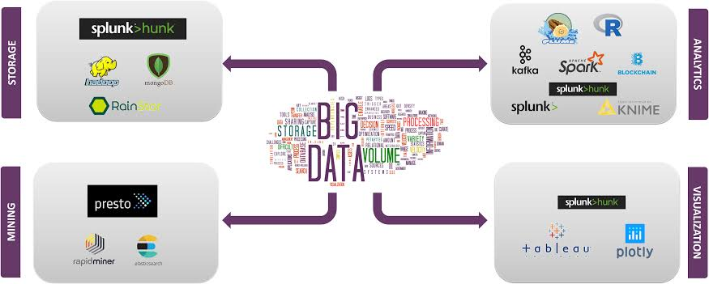
Big Data Technologies
Data storage
Data mining
Data Analytics
Data Visualization

Slide 14
Challenges
Storage
Analytics
Security
Discovery
Quality

Slide 15

Hadoop-as-a-solution
Hadoop, open source framework written in java
Founded by Doung Cutting, was working at Yahoo
Hadoop is named it after his son’s toy elephant
Scalabilty
Distributed file system
The Apache Hadoop framework :
Hadoop common
Hadoop distributed file system(HDFS)
Hadoop Yarn
Hadoop Mapreduce

Slide 17
Architecture

